Slide 1


Beat The Blues
Dr Sacha Burgess
Dr Mitali Agarwal

Slide 2
Key Themes
Food for Mood
Movement for Mood
Sleep Matters
Humans Need Humans
Notes:
20 – 30 min talk
Time for questions
Aim is to educate and empower our patient’s on healthy living and aim to start the new year focussing on improving our lifestyle. We also know that the beginning of the year can feel quite lonely and unmotivating so hopefully this event will help

Slide 3
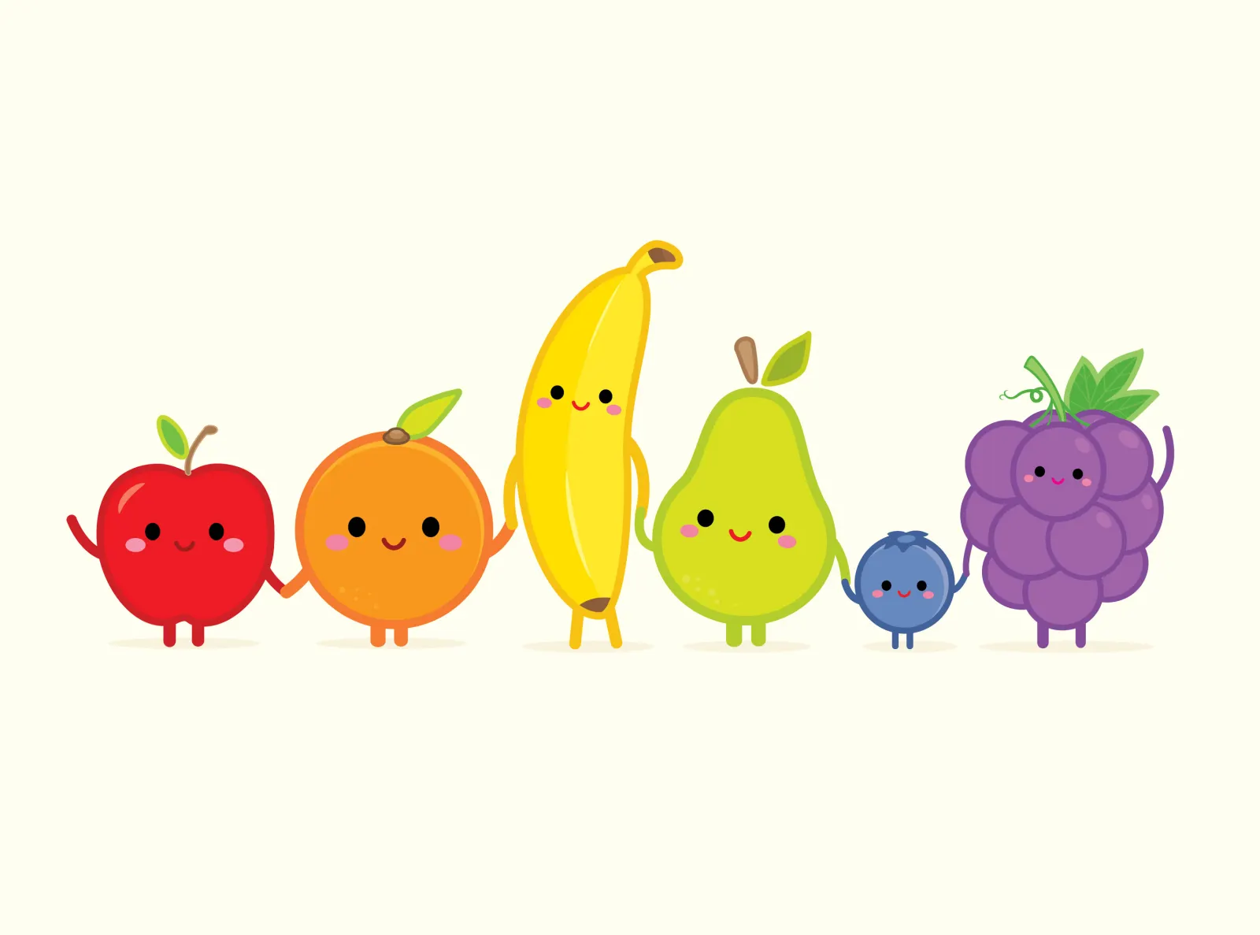

Food for Mood
Easy, realistic swaps
Fibre target: 30g/day (UK avg ~18g)
Improves gut, heart & mood
Found in whole grains, beans, veg, nuts
Notes:
We know that changes to diet can be daunting and expensive, and that there is an abundance of information out there
We don’t want to confuse or stress you out so wanted to think about easy swaps or improvements we could make
Fibre – aim to get 30g a fibre a day, in the UK we average around 18
High fibre diets improve bowel health and cardiac health and reduce the risk of colorectal cancer
Fibre can be found in whole grains, brown rice, beans, lentils, vegetables, nuts and seeds
Fibre has also been linked to improving mood and gut-brain axis
UPF’s
We know that UPFS and high sugar content foods are actually linked to low mood and anxiety alongside a host of medical complications
One study – 50% risk of developing depressions
Swaps where possible to less processed food
Hydration is very important where possible
Caffeine can interfere with sleep, aim to stop caffeine around midday
Supplements
Apt to discuss Vitamin D as weather has been terrible
Alcohol
14 units a week – around 6 glasses of wine or 6 pints
Risk of physical and mental health
Can disrupt sleep and lead to anxiety and low mood

Slide 4
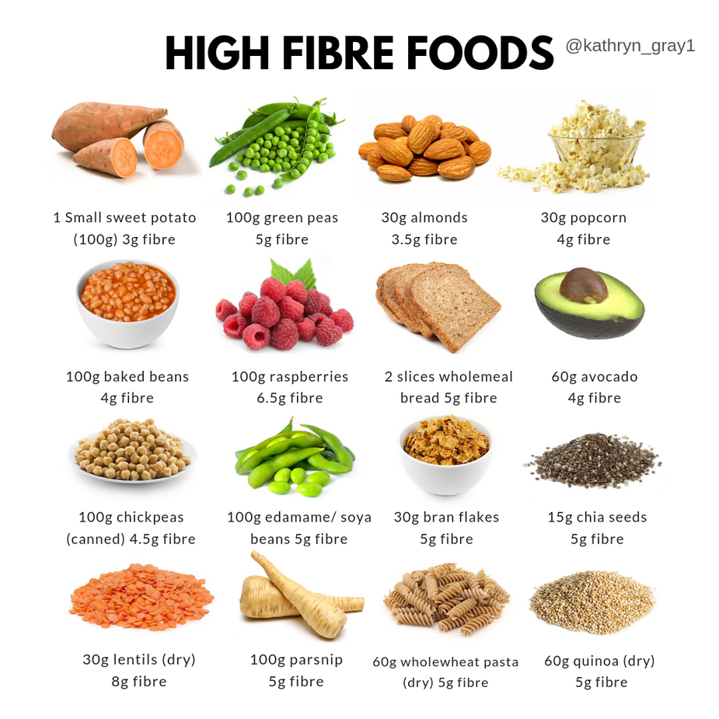

Slide 5
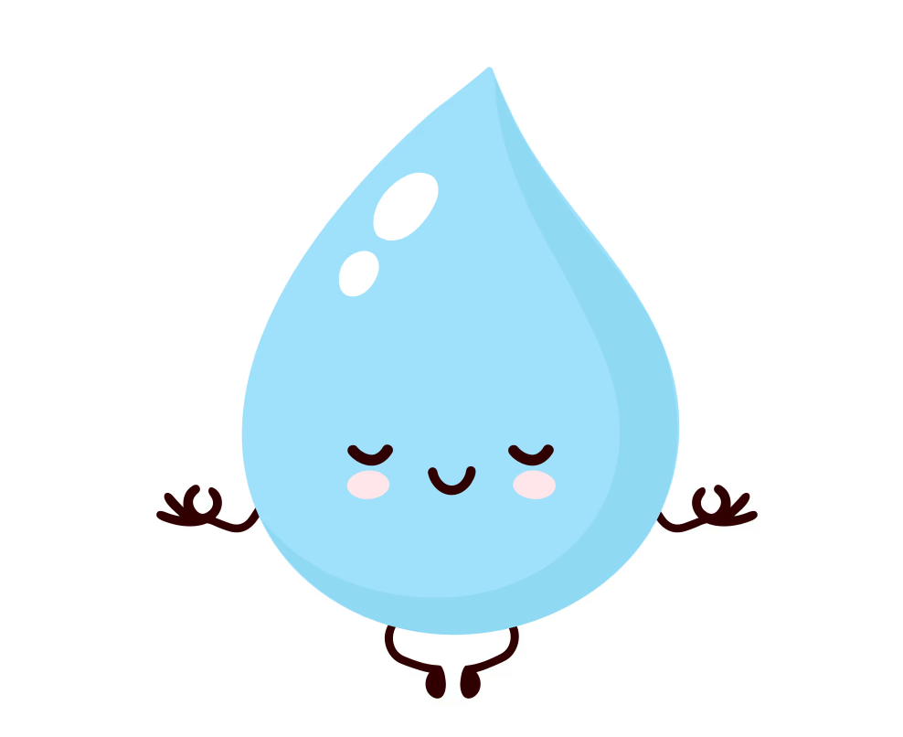
Food for Mood
Reduce Ultra Processed Foods
Linked to low mood and anxiety
Hydration
Supplements
Vitamin D, supports mood, bone health and energy
Vitamin B12, folic acid, iron also affect energy levels and mood regulation
Notes:
We know that changes to diet can be daunting and expensive, and that there is an abundance of information out there
We don’t want to confuse or stress you out so wanted to think about easy swaps or improvements we could make
Fibre – aim to get 30g a fibre a day, in the UK we average around 18
High fibre diets improve bowel health and cardiac health and reduce the risk of colorectal cancer
Fibre can be found in whole grains, brown rice, beans, lentils, vegetables, nuts and seeds
Fibre has also been linked to improving mood and gut-brain axis
UPF’s
We know that UPFS and high sugar content foods are actually linked to low mood and anxiety alongside a host of medical complications
One study – 50% risk of developing depressions
Swaps where possible to less processed food
Hydration is very important where possible
Caffeine can interfere with sleep, aim to stop caffeine around midday
Supplements
Apt to discuss Vitamin D as weather has been terrible
Alcohol
14 units a week – around 6 glasses of wine or 6 pints
Risk of physical and mental health
Can disrupt sleep and lead to anxiety and low mood

Slide 6
Food for Mood
Alcohol
14 units a week
Central nervous system depressant! (although can make you feel good in the moment)
Notes:
We know that changes to diet can be daunting and expensive, and that there is an abundance of information out there
We don’t want to confuse or stress you out so wanted to think about easy swaps or improvements we could make
Fibre – aim to get 30g a fibre a day, in the UK we average around 18
High fibre diets improve bowel health and cardiac health and reduce the risk of colorectal cancer
Fibre can be found in whole grains, brown rice, beans, lentils, vegetables, nuts and seeds
Fibre has also been linked to improving mood and gut-brain axis
UPF’s
We know that UPFS and high sugar content foods are actually linked to low mood and anxiety alongside a host of medical complications
One study – 50% risk of developing depressions
Swaps where possible to less processed food
Hydration is very important where possible
Caffeine can interfere with sleep, aim to stop caffeine around midday
Supplements
Apt to discuss Vitamin D as weather has been terrible
Alcohol
14 units a week – around 6 glasses of wine or 6 pints
Risk of physical and mental health
Can disrupt sleep and lead to anxiety and low mood

Slide 7
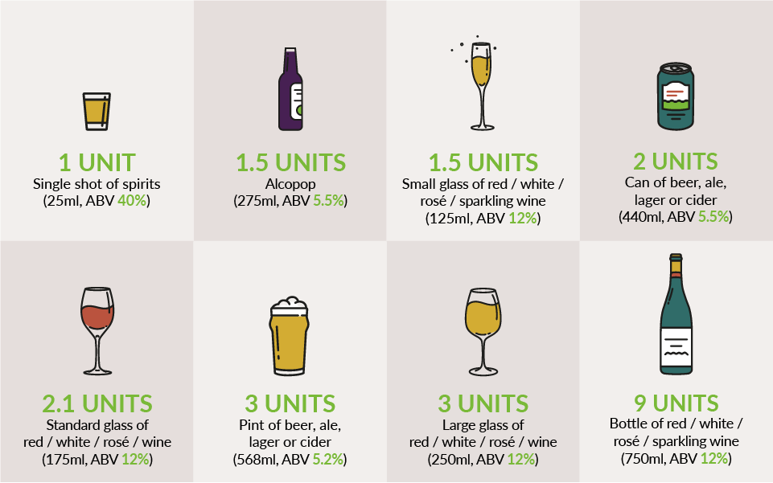

Slide 8
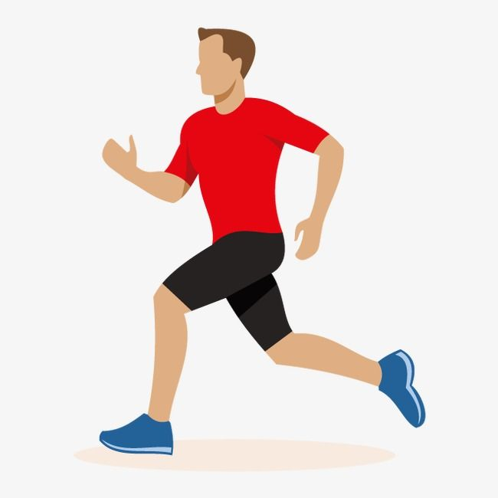
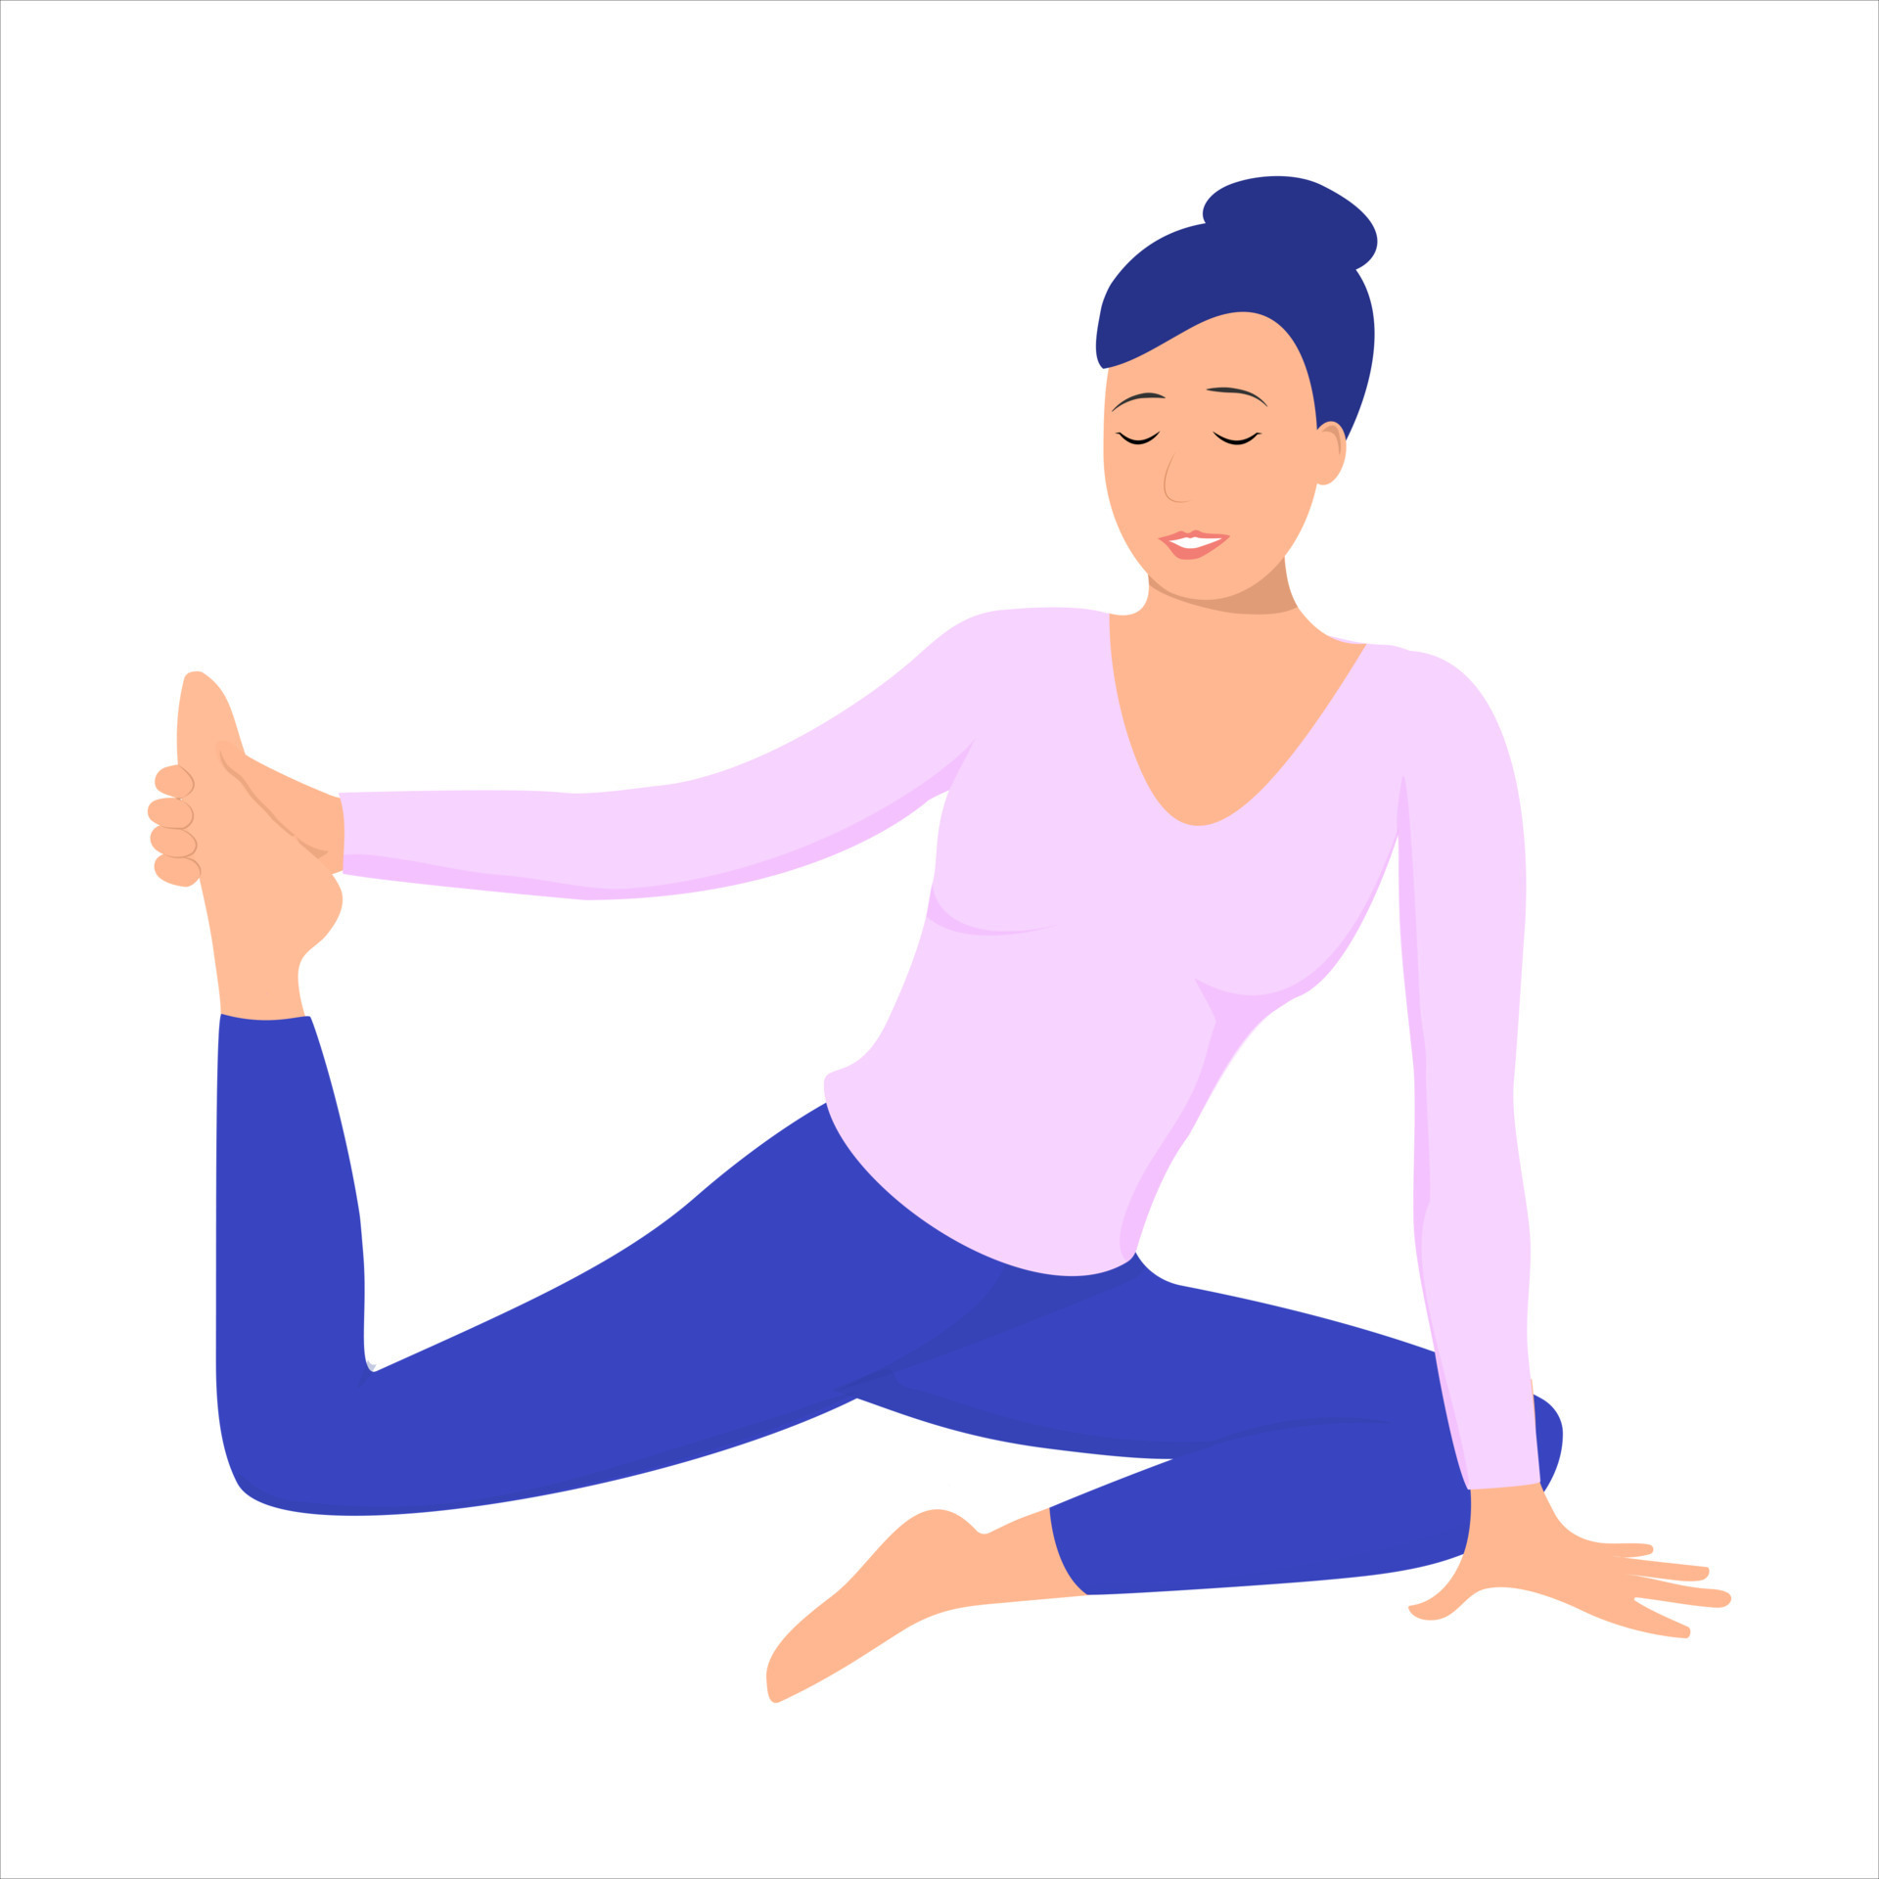
Move your Mood
Endless benefits
Mental health
Heart health
Reduction in Cancer risk
Bone health
Joint pain
Inactive people 3x more likely to have low mood
Any activity is better than none!
Notes:
Benefits are endless -mental health, heart, cancer risk, bowel health, bone health, muscle/joint pain
Inactive people 3x risk of low mood than active people
Any activity better than none – start slow
Walking/swimming/chair yoga/home weight bearing exercising

Slide 9
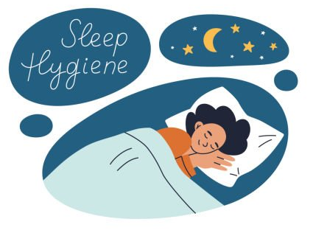
Sleep Matters
20% UK adults struggle with sleep
Impacts mood & stress
Tips
Routine,
No screens
Cool/dark room
Limit caffeine after midday
Notes:
Sleep
20% of UK adults report poor sleep
This could be not getting off to sleep, waking up often in the night time or trouble staying asleep
This can affect our daytime energy, stress response and cause low mood too
Tips to improve sleep
Consistent sleep schedule
No screens an hour before bed
Dark and cool environment
Wind down routines – dim lights, ‘beditation’
NHS how to fall asleep faster and better
If struggling, please speak to GP
Caffeine

Slide 10
Mental Health
Winter months harder
Talking is so important!
Tips
Early morning sunshine
Daily activity
Routine
Notes:
Mental Health
We known in the darker months, mental health is generally poorer – SAD, more loneliness, getting out less, post xmas slump
Most important thing is speaking to people about this (can put resources at the end)
Tips
Early morning sunshine/daily activity and getting out of the house
Keeping routine regarding sleep/work/meals
Tackling loneliness where possible

Slide 11

Loneliness
Increasing levels of loneliness
People are less connected
Linked to poor physical and mental health outcomes
Notes:
Higher levels of loneliness
Less connected
Linked to physical and mental health risks
Many ways to tackle this – community groups, activities, social contact, things like this – lots of recourses below

Slide 12
Resources
GetUBetter
Wandsworth Wellbeing Hub
Care4Me.org
Walking football, charities, cafes, boxing groups, gardening groups
Walk4Life
Free walks
Active Lifestyle
Low cost physical activity
NHS Better Health
Dietary and exercise advice
Every mind matters (sleep and mood)
Guys get active
MIND
CALM
Befriending Network
Wandsworth Discretionary Fund
Social Prescribing

Slide 13
Questions?

